Slide 1
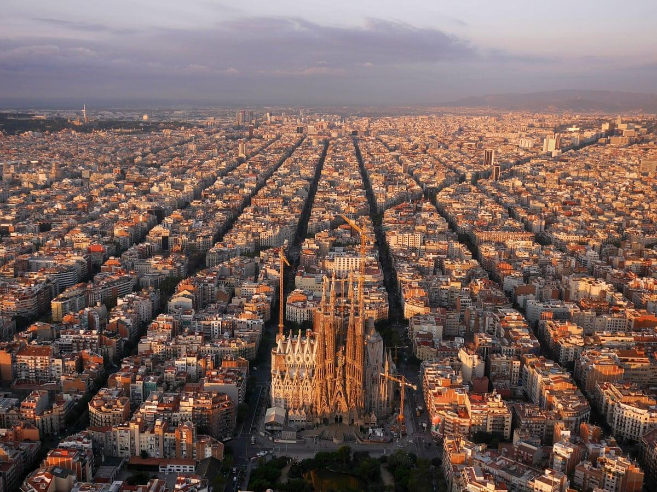
Place as a Sensory Experience
Barcelona Team

Slide 2
Instructions
3.) 15-20 min / Sketch or do Reflective Writing (on paper)
take photos, videos, sound of the sensory experiences
4.) Getting back home/studio
Reflect, think about components that make up the sense of place for you.
What are the insights/experiences that emerged about the place through sensing?
What might be important experiences/stories/sensations to communicate?
Who are the indigenous participants of this place? How might you incorporate other senses in telling their story?
Bring with you to the Walk:
- pen + paper
- camera or phone
- sound recorder or phone (optional)
- Please Work offline
Sensory Walk Instructions (1-2h)
1.) Getting to your site
Pay attention+attune to the chosen 1 sense
2.) 15 min / At your site
Walk around, Pay attention, listen, observe, sense - use the 1 chosen sense
(do not yet take photos, or notes, just be there, sense)
Link to Miro Board
https://miro.com/app/board/uXjVPxCpuWM=/

Slide 3
A Note by Wen
Context:
Walking from my place to my friend’s place. Also dropping by the beach.
Sound:
Kids chattering around school.
Traffic noises.
Wind blowing.
People chattering in language other than Spanish and English.
General reflection:
While I am mainly focusing on ‘sound’ during my exploration, I think smell is the important component that make up the sense of place for me.
I think partly because the chemical in smell can bring you back in time to where you first experience the sensation of that particular smell. I think smell is so powerful that it can mess with our emotion and memory. Even though on my walk, I mostly smell polluted air and tobacco, but when I am having lunch and dropping by the bakery, the fragrance makes me feel content and bring back a sense of familiarity.
Also, I think smell is one of the only senses that is not so accessible by technology. We cannot really access ‘smell’ through our electronic devices just yet. That being said, most of our experience with smell is unadulterated and we are present physically when we smell something.

Slide 4
General Reflections
What are the insights/experiences that emerged about the place through sensing?
I think through the change of the type of sound that I am exposed to, I can tell which part of the city that I am in without needing to look at the map.
What might be important experiences/stories/sensations to communicate?
I guess paying attention to the sensation brings us back to the present moment. Sometimes we forget we all have the power innately instead of depending on the little device that we all have for navigation and exploration.
Who are the indigenous participants of this place?
In my opinion, people are indigenous when they are fully present in the moment. People that are actually living but not showing other people that are living. It makes them indigenous in the present and able to connect, take information from the rest of the objects or item that is there.
How might you incorporate other senses in telling their story?
I think sometimes we could focus on one particular senses by blocking out other sense. For example, blindfolding yourself, so that you can pay attention to other parts of the body sensation, or other things along that line.

Slide 5
SMELL / TASTE / SOUND
Wen’s Exploration

Slide 6
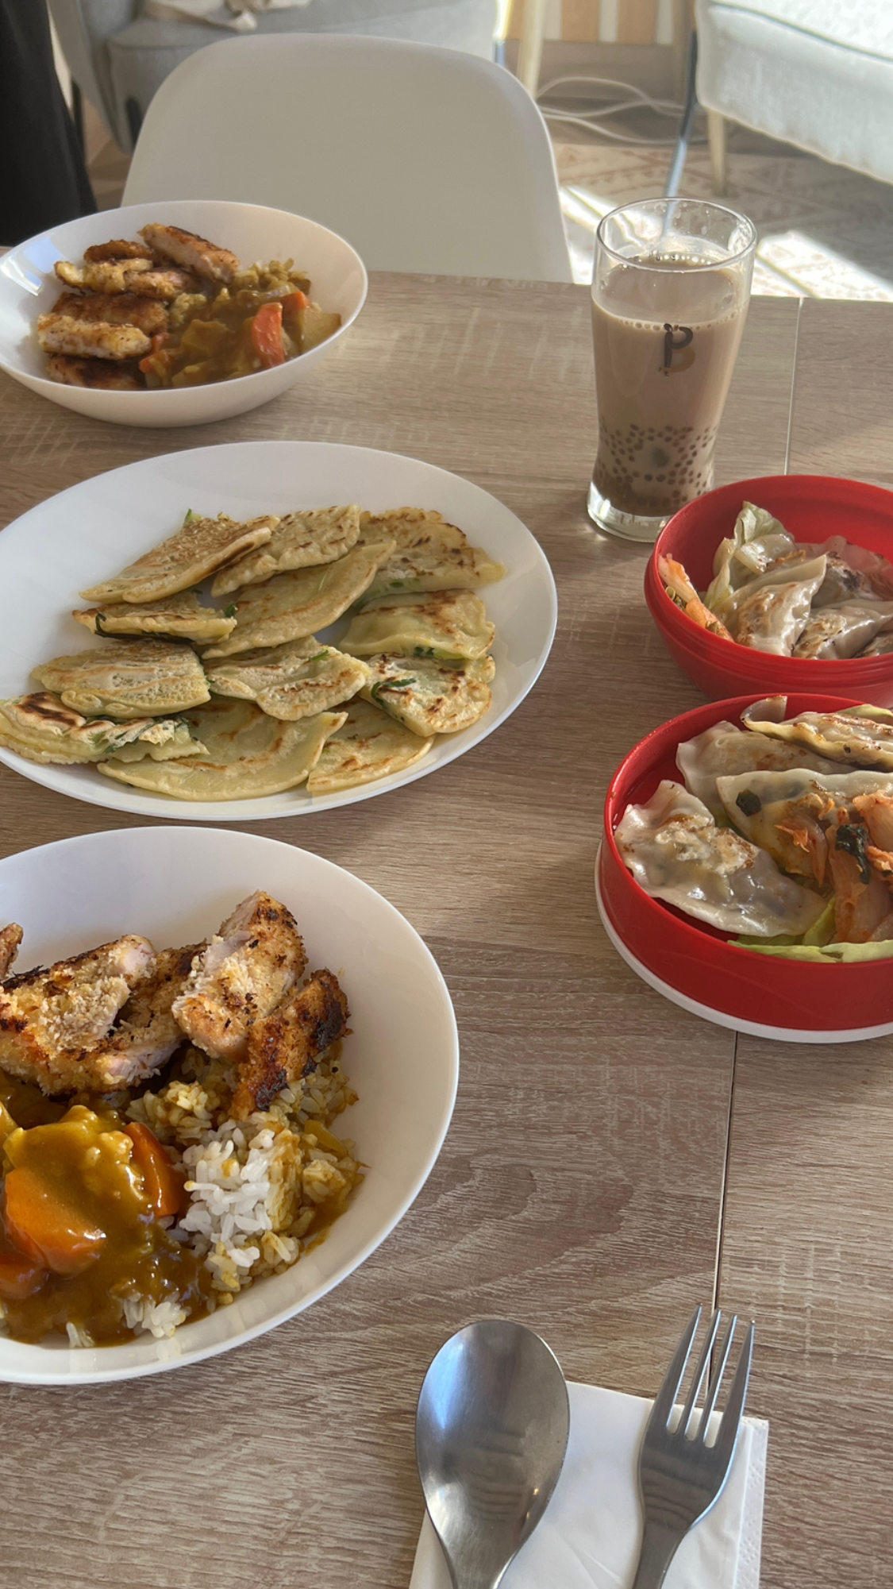
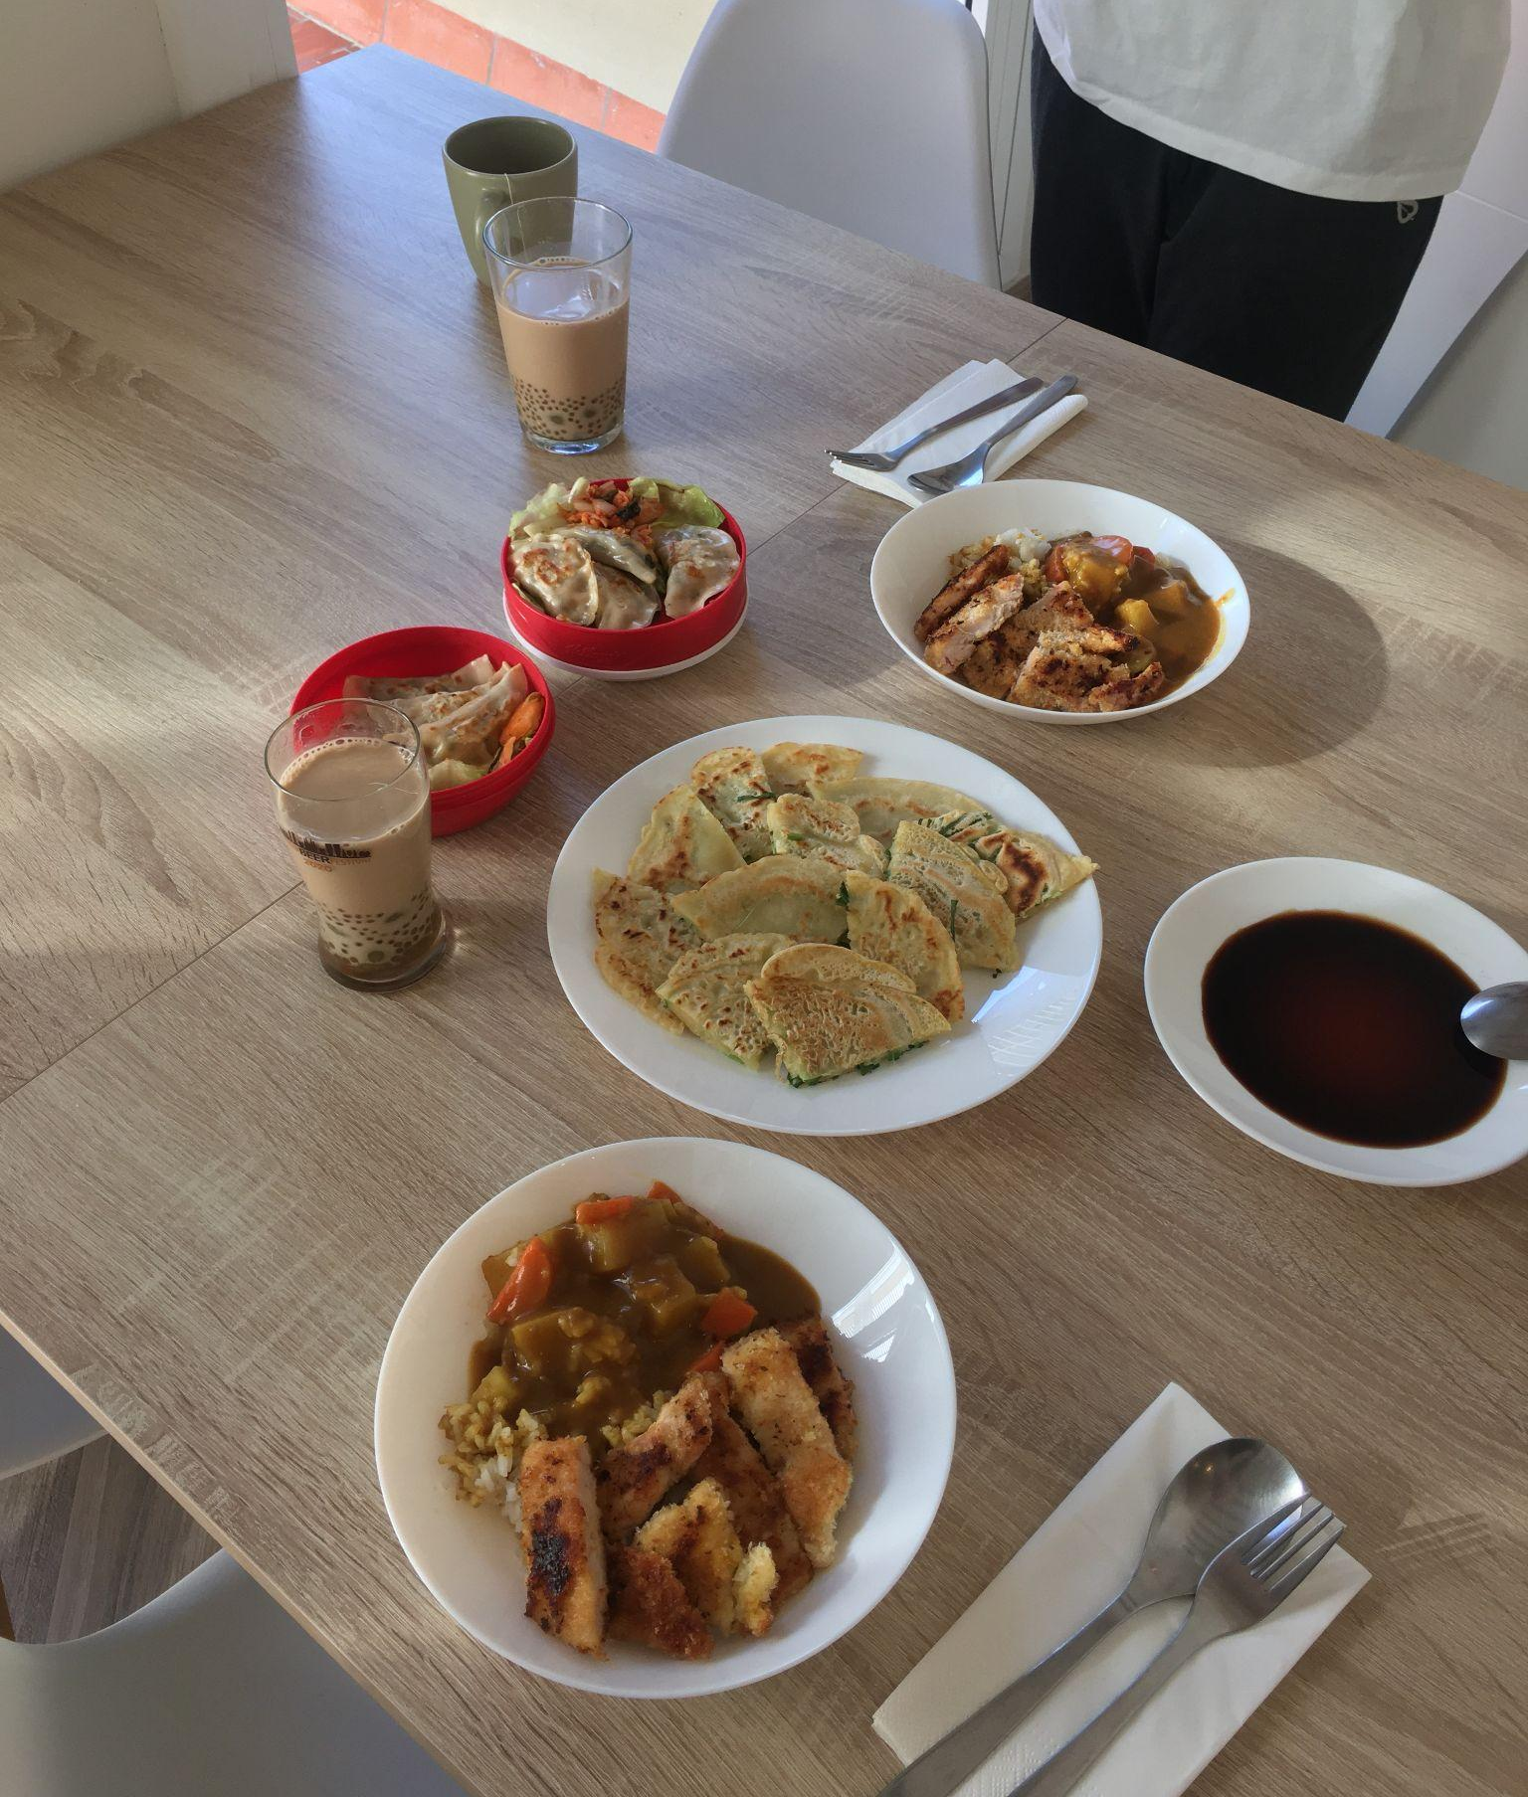
Lunch
I met a friend and we made lunch. We came from mixed cultures but we are eating in the 'Spanish Time' (around 2-3pm). We had homemade milk tea, pajeon (Korean green onion pancake), Katsu Curry Don, and Mandu a.k.a Gyoza or Potstickers.

Slide 7
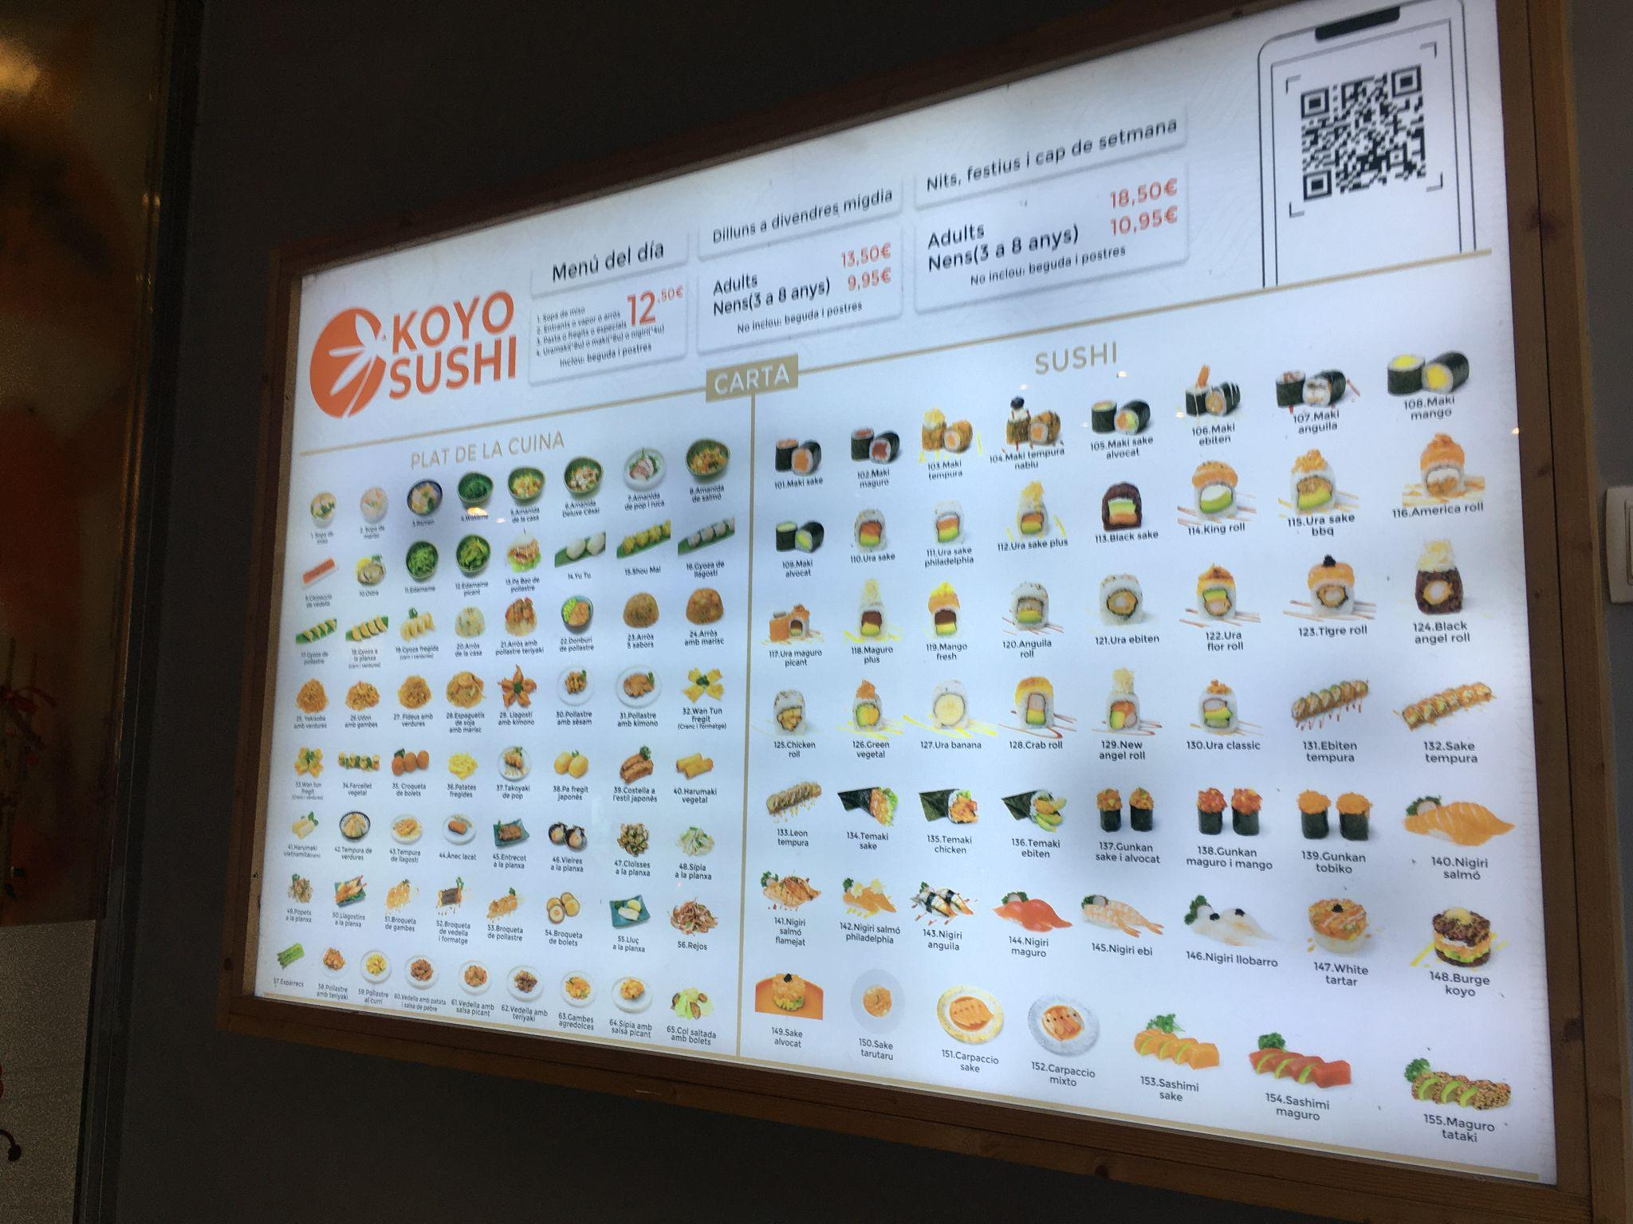
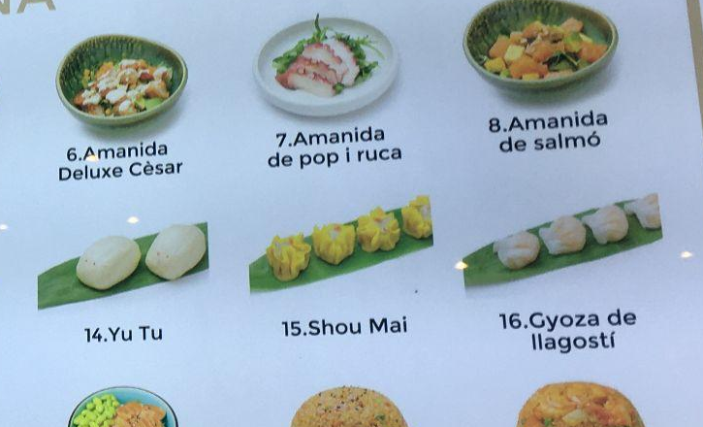
Restaurant
Passed by a supposingly Japanese restaurant in Barcelona but found out that some chinese/canto food is also in the menu, which I find interesting.

Slide 8
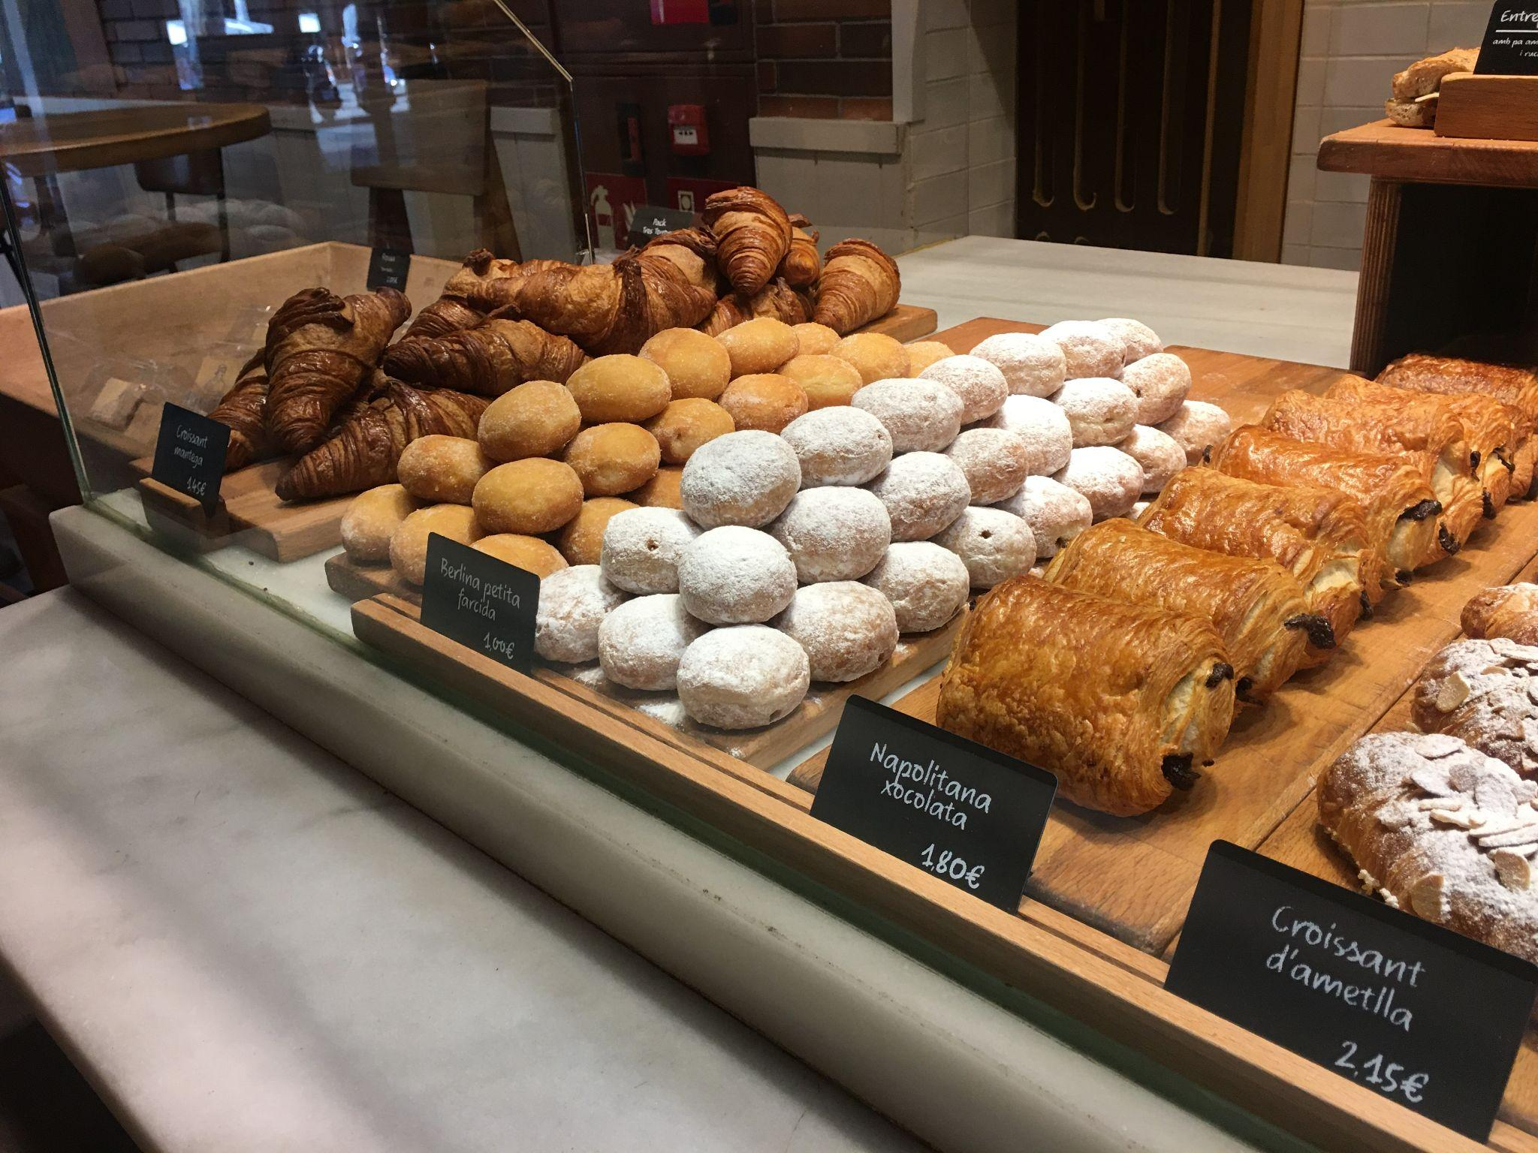
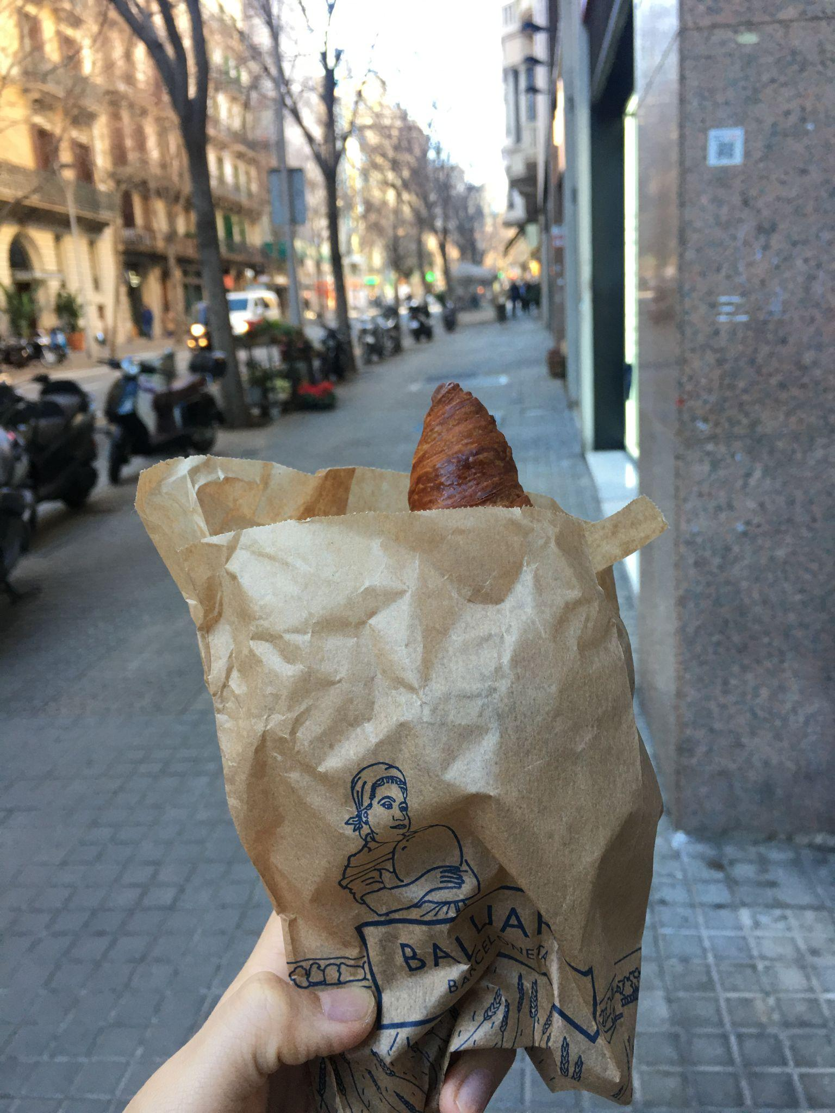
Bakery
Interesting to see what makes a food to be 'indigenous', for example I had a croissant in Barcelona and the pastry has French Origins, but it is from a local bakery. Also scale matters, if we are taking a step backward and see Spain and France as 'Europe', then we can therefore say a croissant is 'indigenous' here.

Slide 9
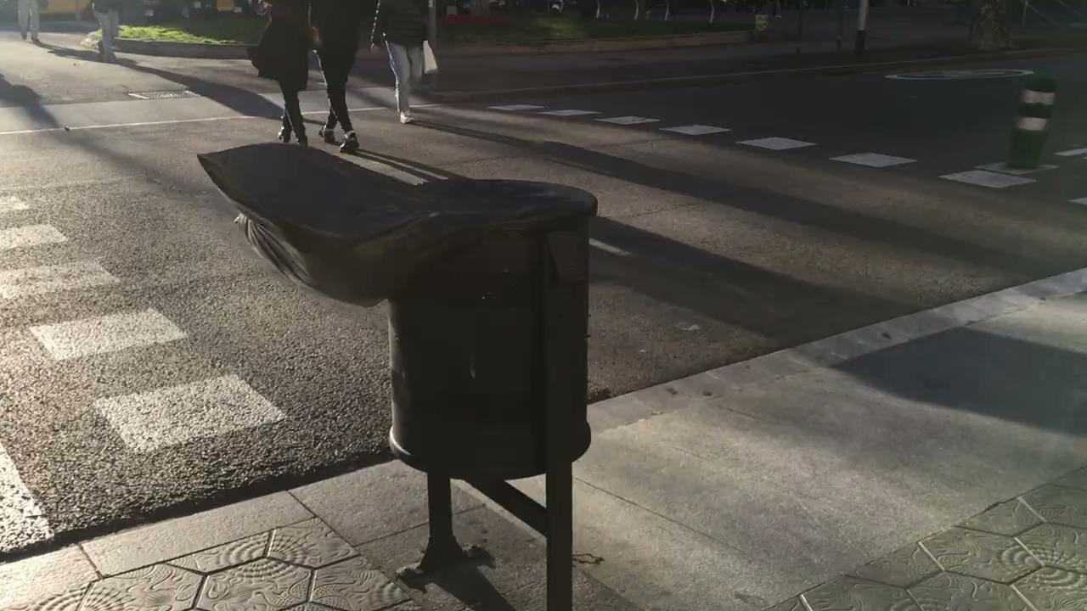
Sound of the Wind

Slide 10
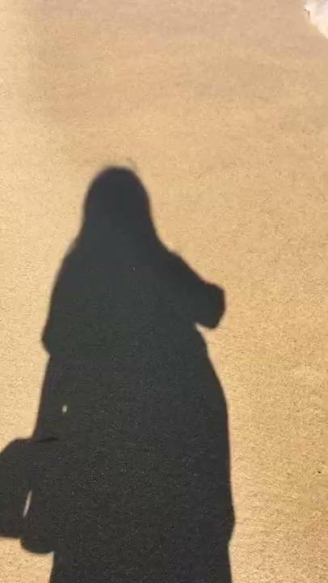
Sound of Waves

Slide 11
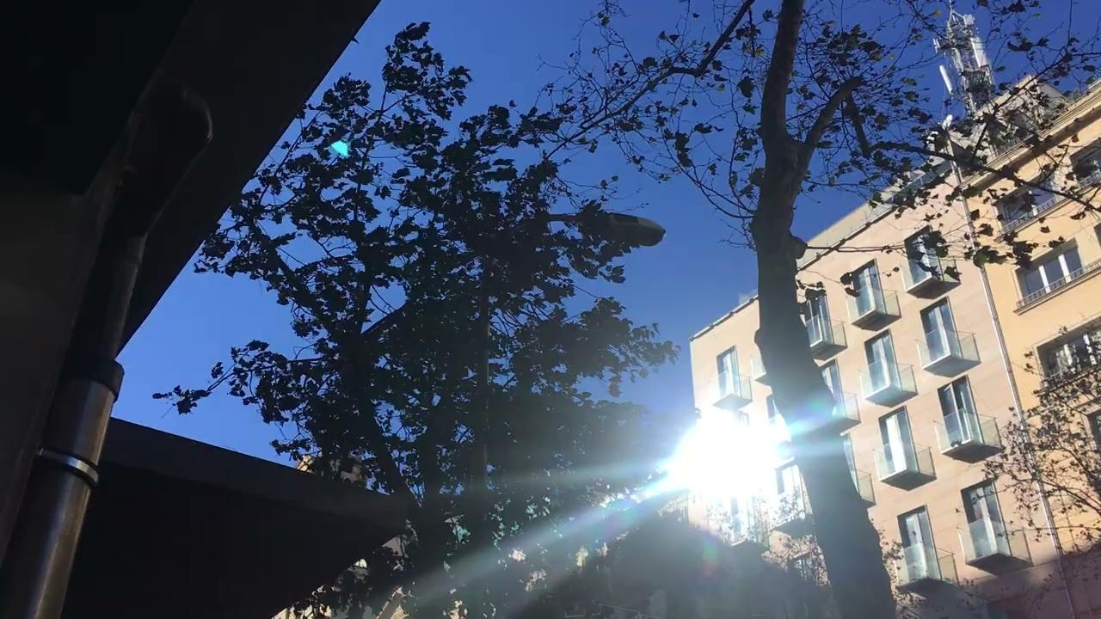
Sound of the Trees

Slide 12
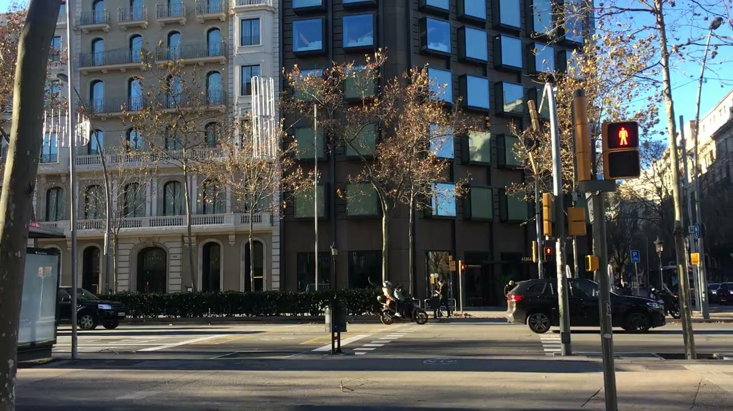
City Vehicles

Slide 13
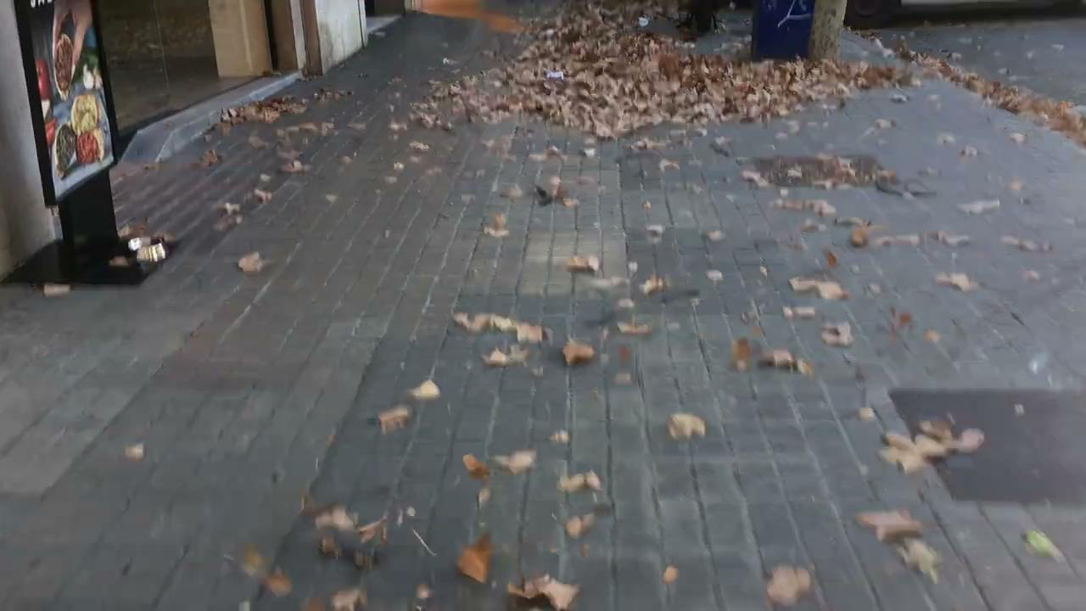
Sound of Crispy Leaves

